Slide 1

NCCoC Quarterly Meeting Charlotte
April 2016
Version 2
27 Mar 2016
NCCoC Membership Program Update
Purpose:
  Establish NCCoC Membership Goals
  Next Steps

Slide 2


NC Council of Chapters based on dues paid
 | NC Council MOAA Membership
 |  | 2014 | 2015 | 2016
NC01 | Cape Fear | 231 | 251 | 242
NC02 | Coastal Carolina | 82 | 77 | 74
NC03 | Eastern Carolina | 35 | 27 | 28
NC04 | Charlotte-Metrolina | 49 | 75 | 104
NC06 | Sandhills | 292 | 300 | 246
NC07 | Southeastern Carolina | 209 | 206 | 205
NC08 | Tarheel Central | 78 | 67 | 86
NC09 | Triangle | 212 | 168 | 122
NC10 | Western Carolina | 129 | 182 | 210
NC11 | Catawba Valley | 51 | 53 | 46
NC12 | Durham-Orange | 20 | 23 | 24
NC14 | Lloyd A. Osborne Piedmont | 22 | 24 | 25
NC17 | First Flight | 37 | 32 | 24
NC19 | First In Freedom | 10
NC20 | Central Carolina | 70 | 74 | 73
NC21 | High Country | 59 | 55 | 57
NC22 | New River | 30 | 39 | 31
 |  | 1616 | 1653 | 1597
"Goals allow you to control the direction of change in your favor."
Brian Tracy

Slide 3
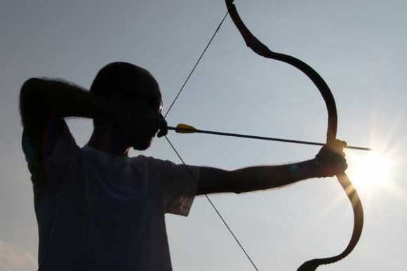
NCCoC Membership Goals
…And the importance of aiming before taking flight.
Give a man a bow and arrow and tell him to, “SHOOT!” and his first response would be, “At what?”
When there is no target there is no purpose for shooting.
He could shoot the arrow anywhere and wherever the arrow ended up would be where the arrow ended up. Not much to it.
On the other hand, if you gave the archer a target and challenged him to hit the bullseye – everything changes.
You now gave him something to aim at, something to challenge his skills against, something to measure his progress with, and something that gives all of his effort – purpose. All by adding in a simple target.
“If you don’t know where you are going, any road will get you there.” Lewis Carroll
http://www.movemequotes.com/top-15-goal-setting-quotes/

Slide 4

NCCoC Membership Goals
Importance of Membership to Chapters, NC Council and MOAA National
  MOAA The ultimate goal for MOAA is to remain the premier military advocacy organization that can affect legislation and make a difference in the quality of life for all members of the military and their families. The more members, the more impact MOAA can have.
  NC Council operates from it’s base of members for NC legislation influence and support for it’s chapters. It’s budget comes from chapter dues based on membership
  Chapters impact local outreach with funds provided by members and fund raisers
NC Council Membership Goals
  2016 through 2017
  Focus on Chapters, not MOAA national
  Sharing of successes among Chapters
“A goal properly set is halfway reached.” ~ Zig Ziglar

Slide 5

NCCoC Membership Goals
OBJECTIVES
  Every Chapter has an active Membership process
  Chapter Membership chair has skill and motivation for success
  Chapter President involved in Membership process
ACTIVITIES
  Support Chapters in an active membership program
    Council leadership to visit Chapters to provide improvement plan
    Share results and successes
    Follow-up with issues and concerns
  Streamer recognition program in place
  All new members reported to MOAA
RESULTS
  New members added to every Chapter each year
  Increase overall membership of NC Council year to year
Goals are pure fantasy unless you have a specific plan to achieve them. Stephen Covey

Slide 6

NCCoC Membership Goals
Next Steps
  Approval of goals
  Develop Check-List for “Active Membership Process”
  Volunteers to support Council Membership Activities
  Monitor Progress, report at Council Meetings
“Whoever wants to reach a distant goal must take small steps.” Helmut Schmidt

Slide 7

Questions?

Slide 8


Back up Slides

Slide 9

MOAA Web Site
Chapters and Councils
  http://www.moaa.org/Content/Chapters-and-Councils/Chapters-and-Councils.aspx
2016 Membership
  Barry’s Letter
  http://www.moaa.org/uploadedFiles/Content/Chapters_and_Councils/Give_Me_Ten!/ChapterRecruitingLetter.pdf
  Program Guide
  http://www.moaa.org/uploadedFiles/Content/Chapters_and_Councils/Give_Me_Ten!/Recruiting_Materials/Final2016CRPGuide.pdf
Recruitment Tracker
  http://www.moaa.org/uploadedFiles/Content/Chapters_and_Councils/Give_Me_Ten!/Recruiting_Materials/Recruitment%20Contest%20Tracker.pdf
New Member Reporting
  https://fs20.formsite.com/moaaweb/2013ChapterRecruiting/secure_index.html

